Slide 1
XGBoost Most Favorable for Breast Cancer Diagnosis
Rachel Khoo
Thinkful Capstone 2
September 2020

Slide 2
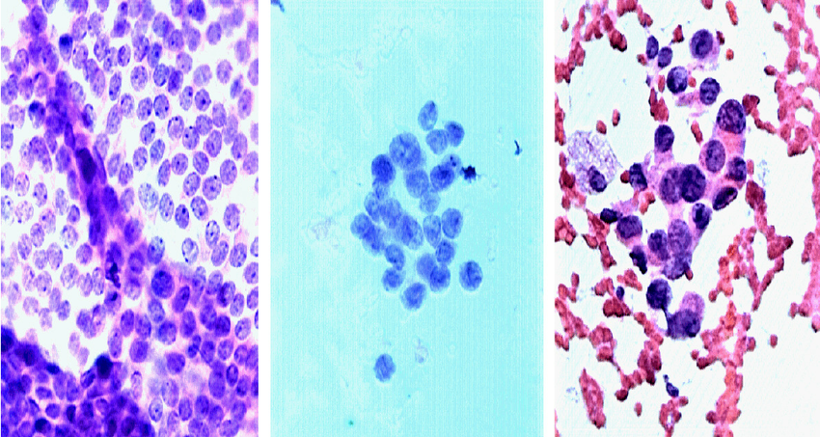
Who has cancer?
Eickhoff, Carsten. (2014). Crowd-powered experts: helping surgeons interpret breast cancer images. ACM International Conference Proceeding Series. 53-56. 10.1145/2594776.2594788.
Notes:
Modified Giemsa stain. Fine needle aspirate

Slide 3
Who has cancer?
Eickhoff, Carsten. (2014). Crowd-powered experts: helping surgeons interpret breast cancer images. ACM International Conference Proceeding Series. 53-56. 10.1145/2594776.2594788.
Notes:
Modified Giemsa stain.

Slide 4
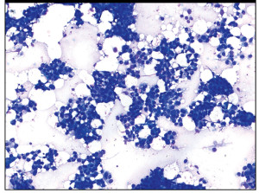
Who has cancer?
https://www.captodayonline.com/cytopathology-standardized-reporting-breast-fnab-cytology/

Slide 5
Machine Learning can make diagnosis easier
Area: 1001.0
Texture: 10.38
Compactness: 0.27760
Concavity: 0.3001
Notes:
Finding a way to automate this process can be another project

Slide 6
Machine Learning can make diagnosis easier
Area: 1001.0
Texture: 10.38
Compactness: 0.27760
Concavity: 0.3001
Machine Learning Model
“Malignant”

Slide 7
XGBClassifier is the best model
Accuracy: 95%
Recall: 96%
 | Predicted Benign | Predicted Malignant
True Benign | 68 | 4
True Malignant | 2 | 40
Notes:
Scaled and dropped

Slide 8
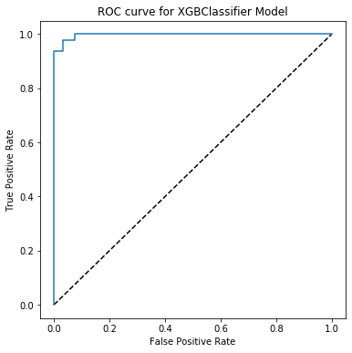
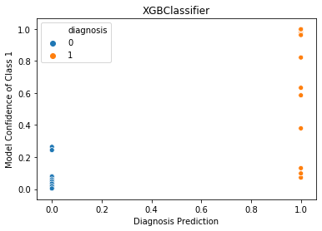
XGBClassifier is confident and accurate
Notes:
Receiver operating characteristic – a visualization of how good the model is at predicting classes, want to be a right triangle

Slide 9
Logistic Regression: Accuracy isn’t everything
Accuracy: 96%
Recall: 93%
 | Predicted Benign | Predicted Malignant
True Benign | 71 | 1
True Malignant | 3 | 39
Notes:
Scaled and dropped

Slide 10
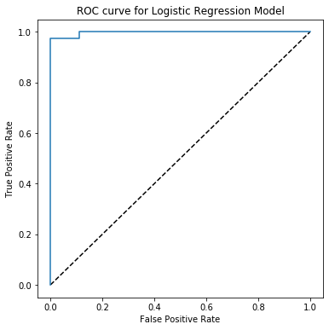
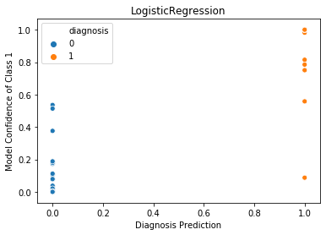
Logistic Regression is more confidently wrong

Slide 11
K Nearest Neighbors (KNN): Good accuracy, poor recall
Accuracy: 96%
Recall: 91%
 | Predicted Benign | Predicted Malignant
True Benign | 71 | 1
True Malignant | 4 | 38
Notes:
Must scale data

Slide 12
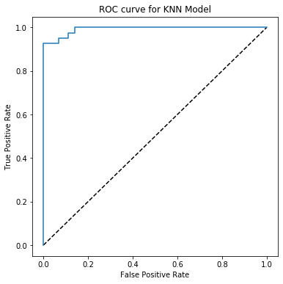
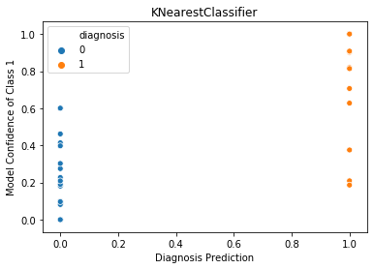
KNN can still be useful

Slide 13
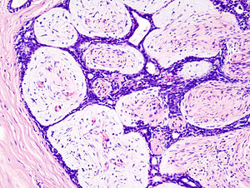
Every model has limitations
XGB
Can’t predict outside of sample
Logistic Regression
Can be slow
KNN
Slower
Not easily interpretable
Can’t predict outside of sample
XGBClassifier
?
Notes:
Logistic regression has convergence issues

Slide 14
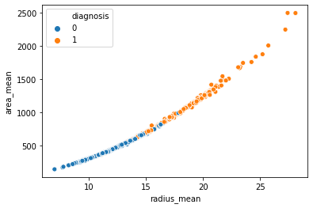
How can we improve accuracy?
More data
Spend more time tuning hyperparameters
PCA to reduce complexity
redundancy
Notes:
Dataset was only 569 rows
Use PCA to reduce redundancy

Slide 15
An ensemble method could be even better
XGBClassifier
Logistic Reg.
KNN
“Benign”
“Benign”
“Malignant”

